Slide 1

Learn. Imagine. Build. .NET Conf
Beyond Mobile: Server, Games and more
with Visual Studio for Mac
Mikayla Hutchinson
@mjhutchinson

Slide 2

Modern Multi-Platform .NET IDE
Native Mac experience
End-to-end .NET dev on Mac
Xamarin, ASP.NET Core, Unity
Azure Functions, IoT

Slide 3
Built on .NET
Visual Studio for Mac
MonoDevelop
Roslyn
NuGet
MSBuild
dotnet
templating
VSTest
…
Mono

Slide 4
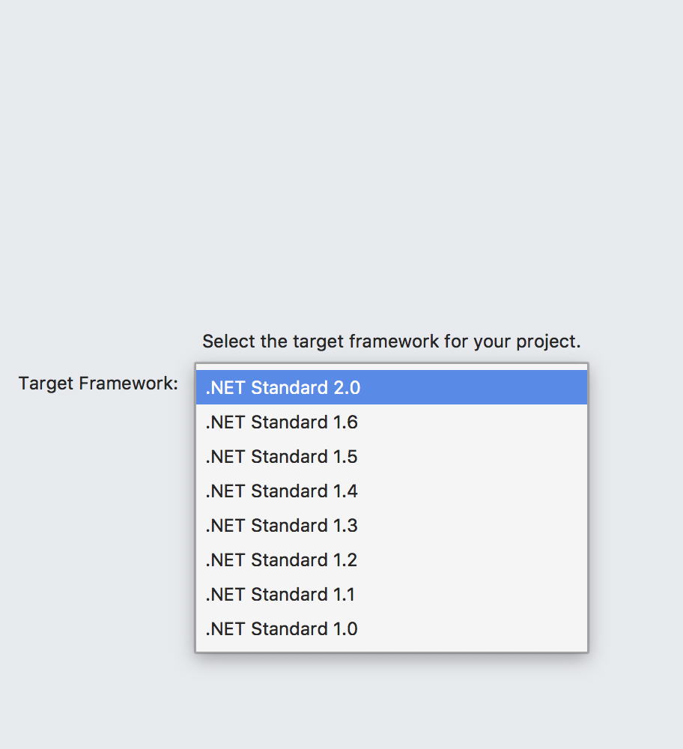
.NET Standard
Full .NET Standard support
Huge ecosystem of libraries via NuGet
Share code between apps for
different platforms

Slide 5
ASP.NET Core
Fast, modern, open-source
Web sites and cloud backends
Running on .NET Core

Slide 6
Demo: ASP.NET Core

Slide 7
Xamarin.Mac
macOS Cocoa apps with C# and F#
Shares core with Xamarin.iOS https://github.com/xamarin/xamarin-macios
Xamarin.Forms support in preview
Visual Studio for Mac uses this!

Slide 8
Demo: Xamarin.Mac

Slide 9
Unity
Popular, easy-to-use game engine
Huge number of supported platforms
Great choice for HoloLens, AR, etc

Slide 10
Demo: Unity

Slide 11

Azure Functions
Serverless
Familiar development model
Preview based on Mono,
moving to .NET Core 2

Slide 12
Demo: Azure Functions

Slide 13

IoT
Remote deploy and debug
Any device running Linux, SSH and Mono, e.g. Raspberry Pi
Publish using mkbundle

Slide 14
Demo: IoT

Slide 15
BUT WAIT,
THERE’S MORE!

Slide 16
Mono for Unreal Engine
Gameplay code in C#
Full binding to Blueprint accessible type system
https://mono-ue.github.io

Slide 17
Netduino
OSS embedded hardware platform
Arduino-compatible pinout
.NET Micro Framework
https://www.wildernesslabs.co

Slide 18
Wrapping Up!
Comprehensive .NET IDE for Mac
Cloud, mobile, desktop, serverless, games, IoT
Download: aka.ms/vsmac
Docs: aka.ms/vsmac-docs
Labs: aka.ms/vsmac-labs

Slide 19
.NET

